Slide 1
Arts & Crafts with AWS Glue
ETL Workshop

Slide 2





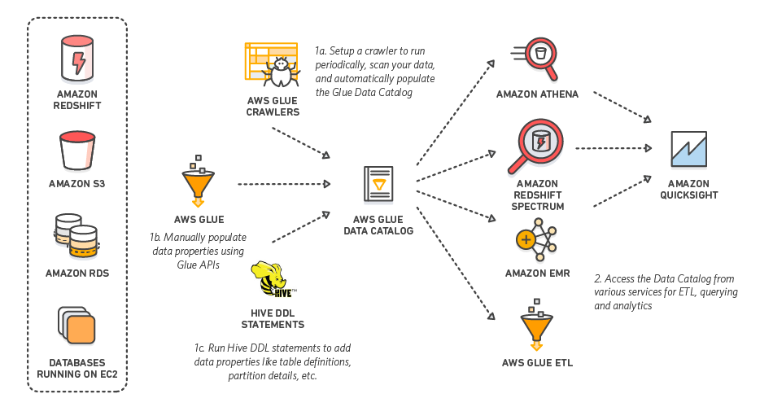



Amazon Web Services
Data File
S3
Glue
Redshift
QuickSight
Glue Crawler
Athena
SQL Workbench/J

Slide 3
AWS Glue
What is Glue?

Slide 4
AWS Glue
Amazon Web Services tool to Extract, Transform, and Load(ETL)
Used to prepare data for business analytics
Notes:
One of these tools is Glue, which will be the focus of our talk

Slide 5
ETL
Extract: Pull data from a source
Files
Database
Reporting Tool
Transform: Modify the data to fit your needs
Add new columns like data source or timestamp
Remove unwanted data
Alter data with calculations
Load: Store in your database

Slide 6
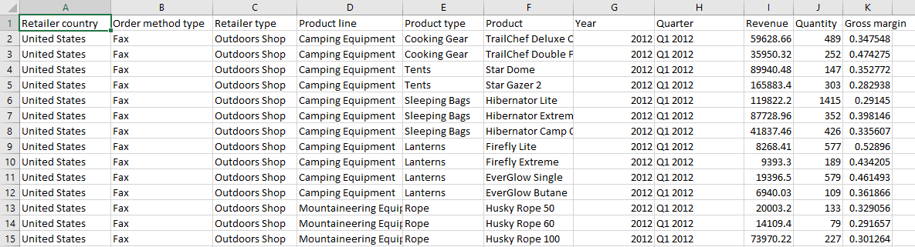
ETL
Original Data File(WA_Sales_Products.csv)
Example Business Requirements:
Remove the Year from Quarter
Add a profit column from revenue * gross margin columns
Add a current date column

Slide 7
Why use Glue?
Serverless
companies do not have to invest and maintain on premise servers
Easily scalable
adjust storage needs up and down based on need
Cost Effective – Glue is cheaper than other ETL Services
Only pay when being used, where Matillion and Informatica charge hourly or yearly
Matillion: $2.74 per hour (m4.large EC2), Informatica $3.66 per hour (m4.large EC2), Glue $0.44 per DPU-Hour
Code based (Python or Scala) so you can do anything you can program
Easy integration with other AWS tools
Automatic error handling and logging

Slide 8
AWS vs. Hadoop
Hadoop – A popular platform used to store and transform big data
AWS is more flexible – scale up or down storage based on need
AWS is less complex – no need to set up and maintain servers
AWS cheaper
Start up cost
Maintenance cost
Pay as you go
Hadoop has challenges handling a lot of small files
AWS – End to End solution for data needs
Storage
Transform
Business Intelligence
ETL & ELT(AWS) vs. ELT(Hadoop)
Durability
Data stored in multiple locations within region
If a location fails data is still available

Slide 9



Glue Tutorial Overview
Setup Redshift Cluster
S3 bucket for storing the file
Athena table to access data in file
Glue connection
Glue job
Connect To Redshift in SQL Workbench
Create Redshift table
Run Glue job
QuickSight
Data File
S3
Glue
Redshift
QuickSight
Glue Crawler
Athena
SQL Workbench/J

Slide 10
Glue Tutorial Prerequisites
Prerequisites :
Setup AWS Account (Personal or Temporary)
https://portal.aws.amazon.com/billing/signup
http://escab.juddsolutions.com/registration/create
Clone or save git repository https://github.com/jayzandme/aws-glue-tutorial.git
download SQL Workbench/j https://www.sql-workbench.eu/
download Redshift JDBC driver https://docs.aws.amazon.com/redshift/latest/mgmt/configure-jdbc-connection.html#download-jdbc-driver
Notes:
lw

Slide 11

Redshift
Create AWS Data Warehouse
Data File
S3
Glue
Redshift
QuickSight
Glue Crawler
Athena
SQL Workbench/J
Notes:
For the rest of the labs we will talk through what to do, and give you time to do everything afterwards

Slide 12
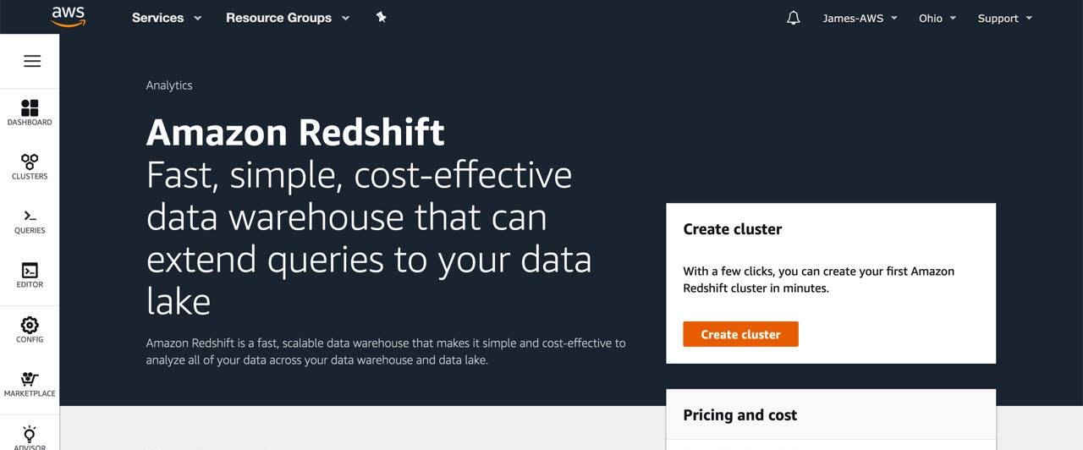
Redshift
Create AWS Data Warehouse

Slide 13
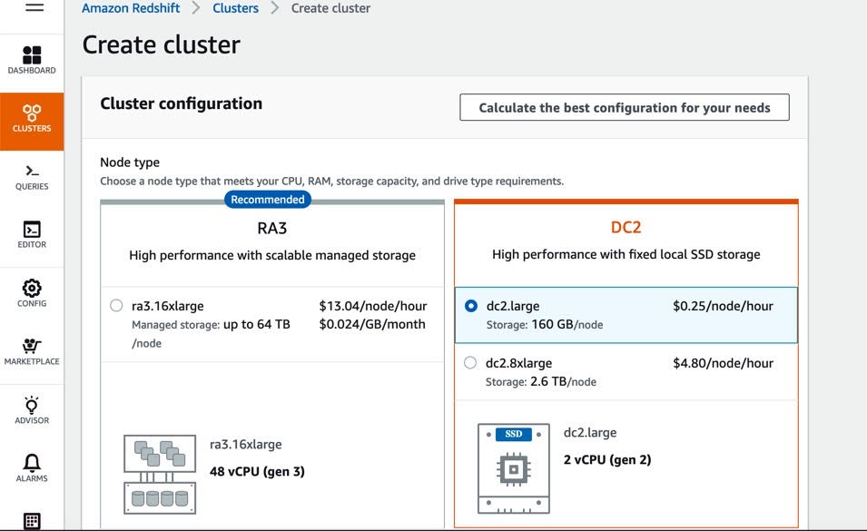
Redshift
Create AWS Data Warehouse

Slide 14
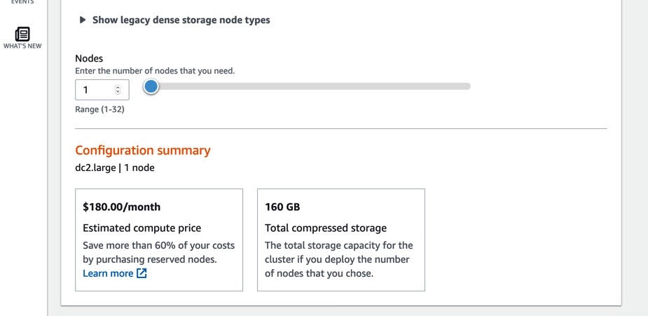
Redshift
Create AWS Data Warehouse

Slide 15
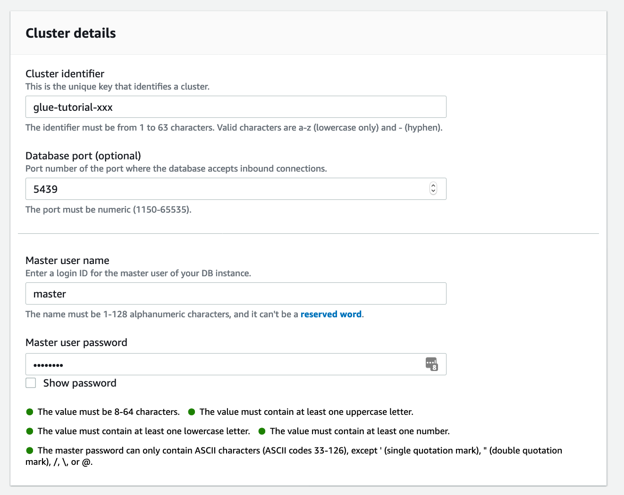
Redshift
Create AWS Data Warehouse
Specify Cluster Name
Create a user
Create a password for the user
Notes:
Your cluster needs to have a unique id so if you're using the shared account, using your initials is especially important.
We will be using this name again in later slides so it is highly recommended that you use our name format.

Slide 16
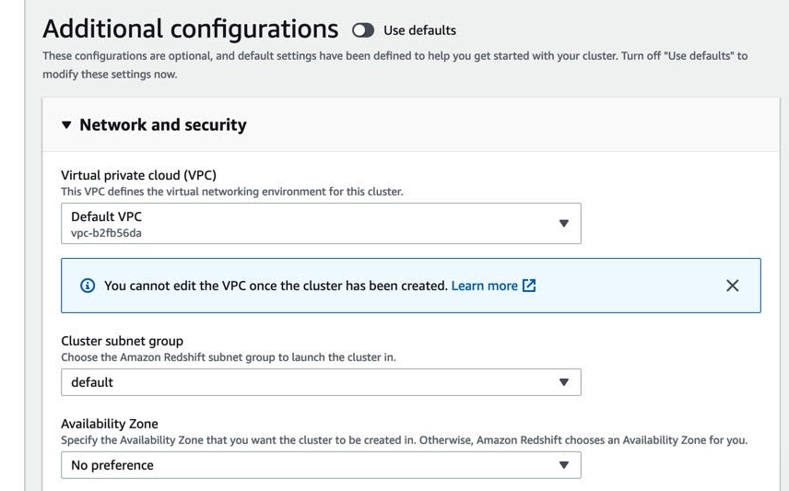
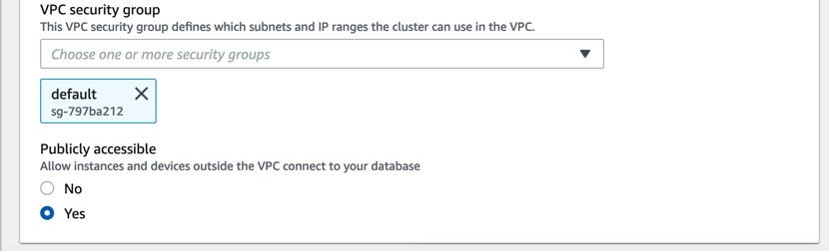
Redshift
Create AWS Data Warehouse
Unclick ‘Use defaults’
Take note of the VPC id for later
Change ‘Publicly Accessible’ to Yes
Notes:
We are toggling publicly accessible to yes just to make sure you can access Redshift with Sql Workbench but you may not need to or want to when setting up clusters for your work place.

Slide 17
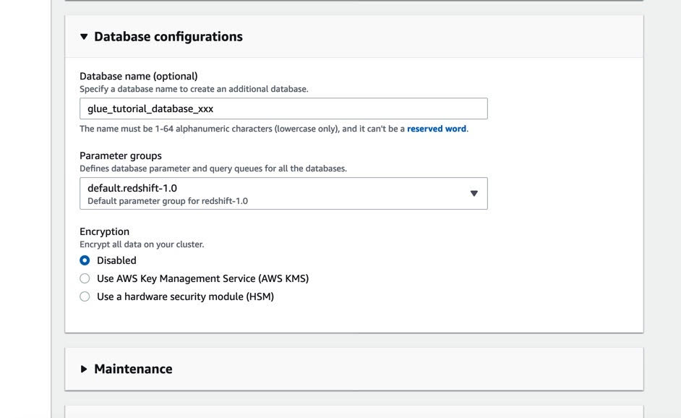
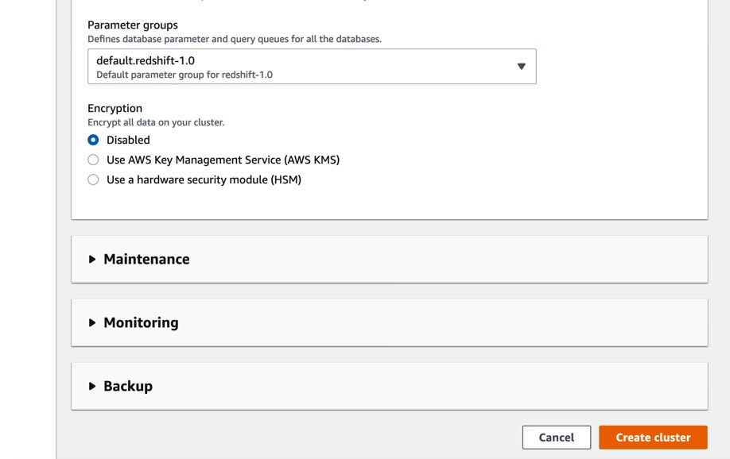
Redshift
Create AWS Data Warehouse
Give your cluster a Database to start with

Slide 18
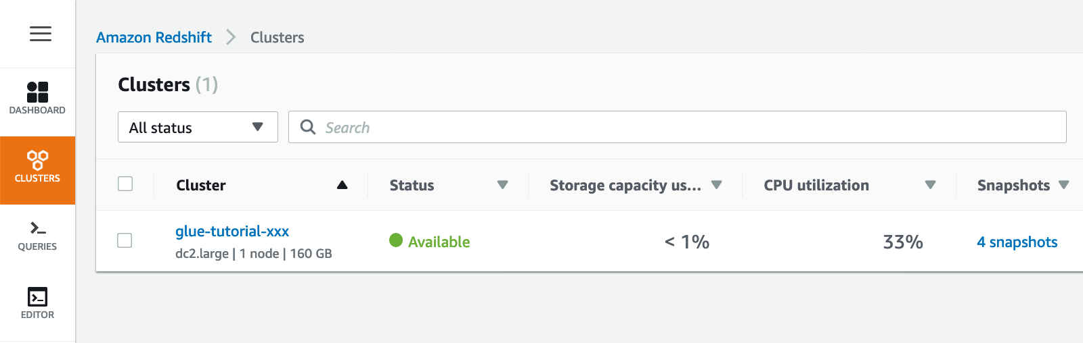
Redshift
Create AWS Data Warehouse

Slide 19
Lab 1
Launch Redshift cluster
(Use US-EAST-2/Ohio Region)
Notes:
jz

Slide 20
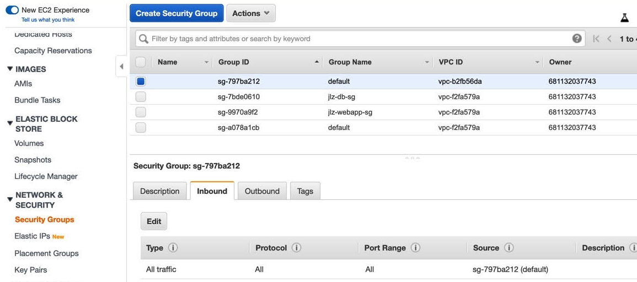
EC2
In a new tab go to the EC2 service
Edit Security Groups

Slide 21
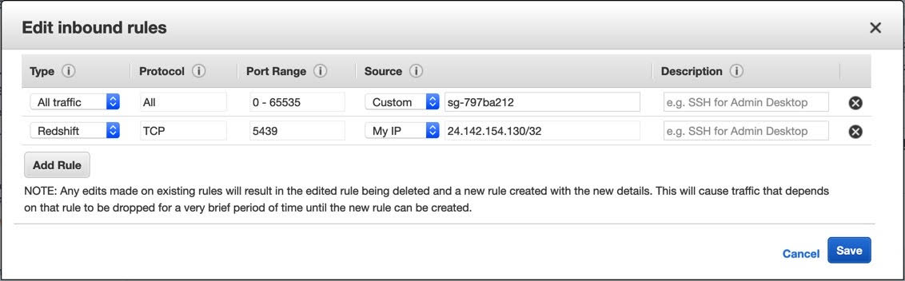
EC2
Edit Security Groups
Choose Redshift Type
Specifies who has access to the Redshift cluster

Slide 22
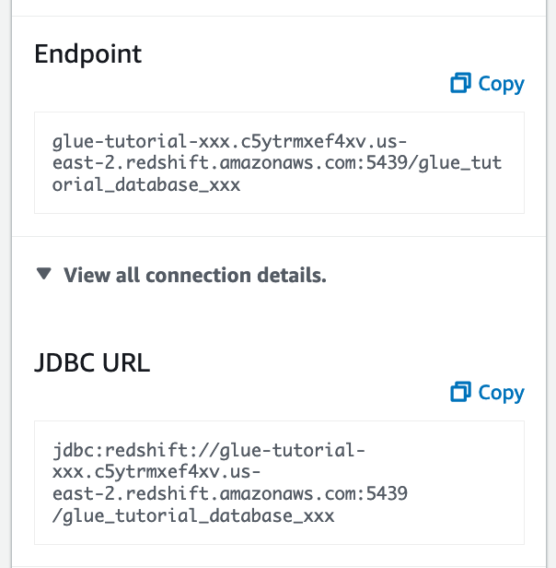
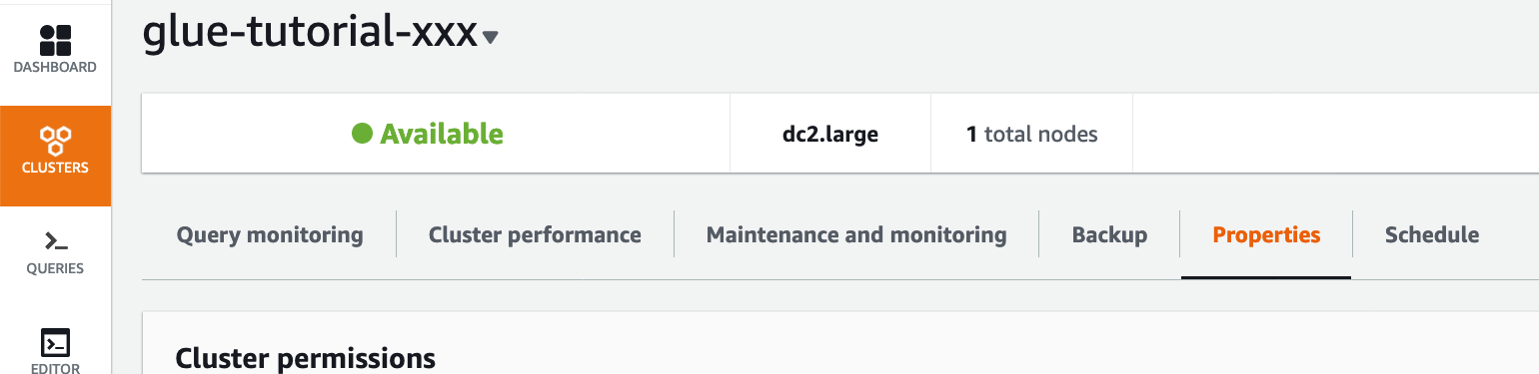
Redshift
Connection
Go to Redshift and select ‘Clusters’
Select glue-tutorial-xxx
Scroll down to Cluster Database Properties and copy the JDBC URL
Select Properties

Slide 23
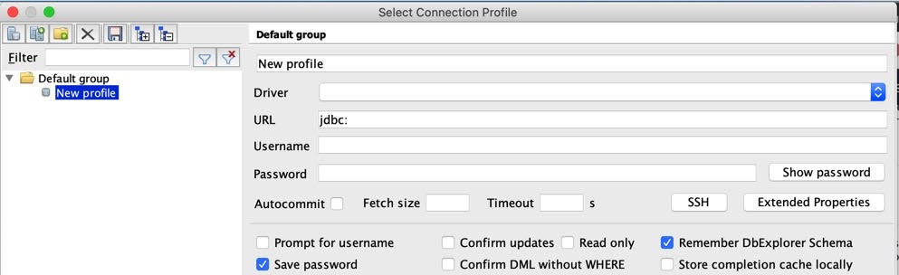
Redshift
Connection
Open SQL Workbench and select Create a new connection
Set the Driver to Amazon Redshift

Slide 24
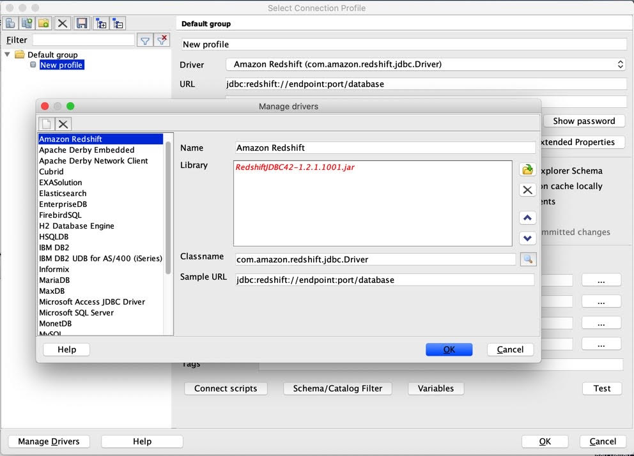
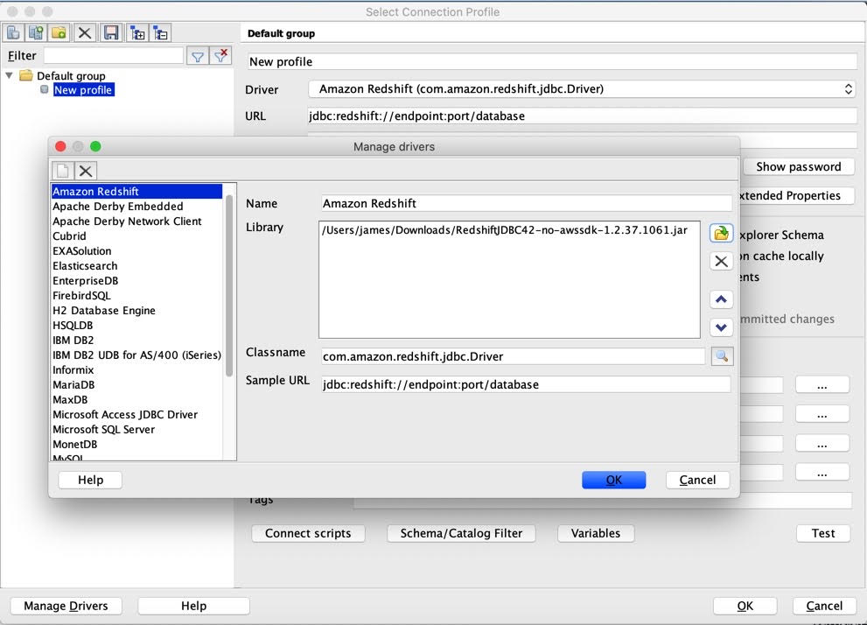
Redshift
Connection
Select the Redshift JDBC Driver you downloaded earlier
Choose the file

Slide 25
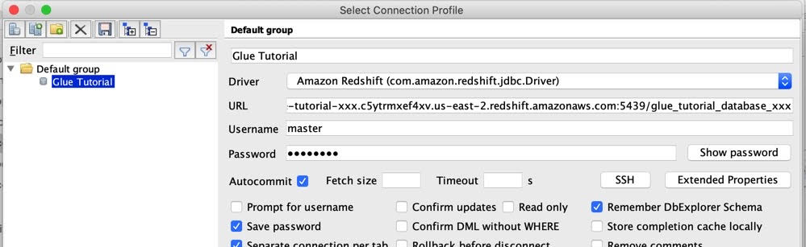
Redshift
Connection
Paste the JDBC URL
Enter the username and password that you created
Select Autocommit

Slide 26
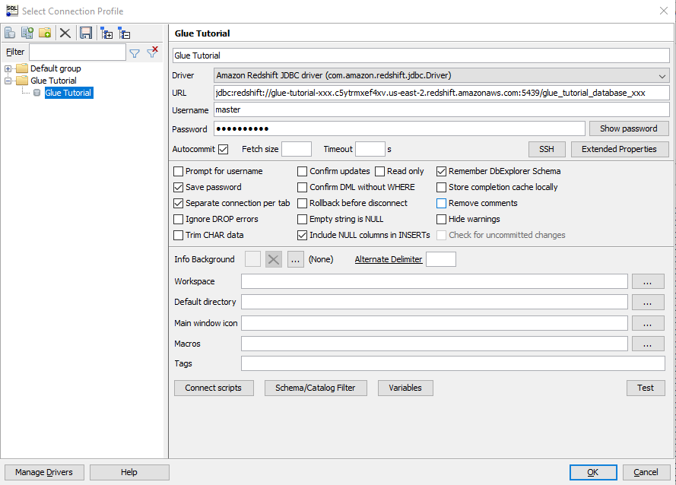
Redshift
Connection
Test your connection

Slide 27
S3
Create S3 bucket with AWS Console
Data File
S3
Glue
Redshift
QuickSight
Glue Crawler
Athena
SQL Workbench/J
Notes:
Amazon Simple Storage Service - S3

Slide 28
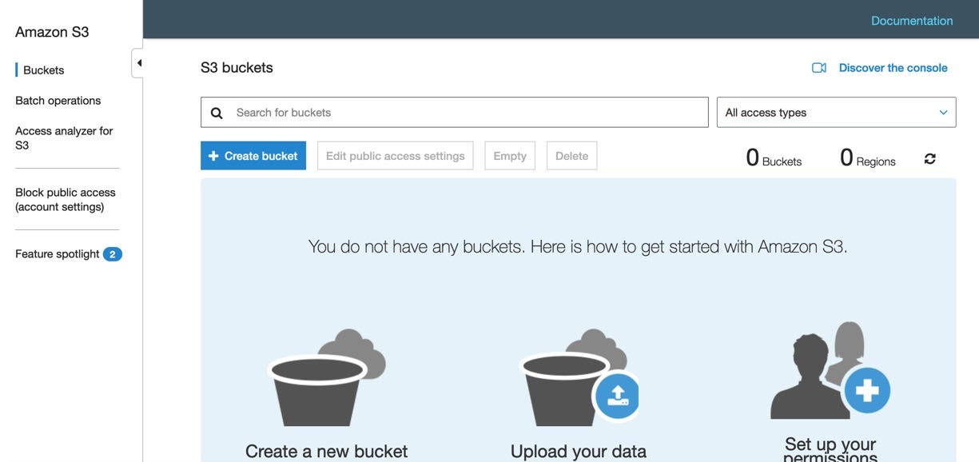
S3
Create S3 bucket with AWS Console

Slide 29
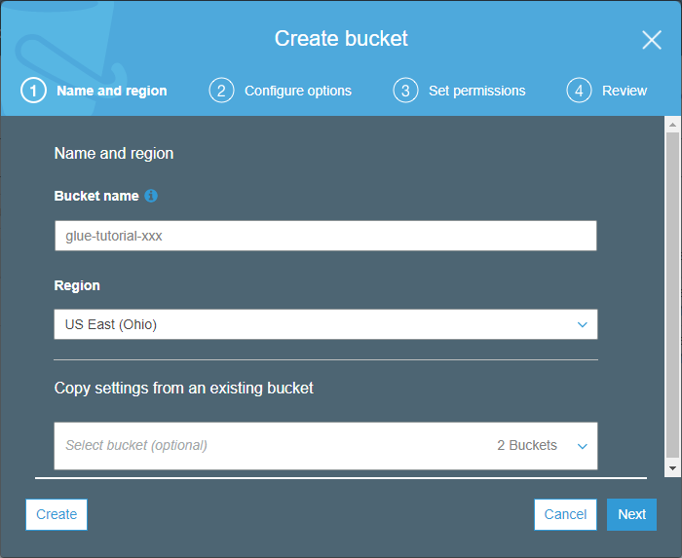
S3
Create S3 bucket with AWS Console
Give your S3 bucket a name
Use glue-tutorial-XXX
Your bucket name needs to be unique because these are accessible across all regions and by potentially everyone
Specify the region

Slide 30
S3
Create S3 bucket with AWS CLI* (Alternative)
$ aws s3api create-bucket --bucket glue-tutorial-XXX --region us-east-2
* Must install and set up AWS CLI in order to use this

Slide 31
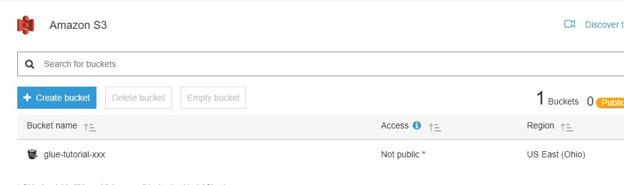
S3
Create S3 bucket with AWS Console

Slide 32
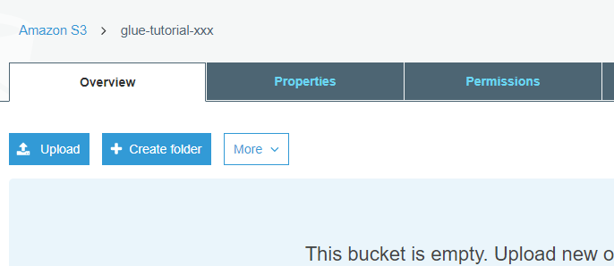
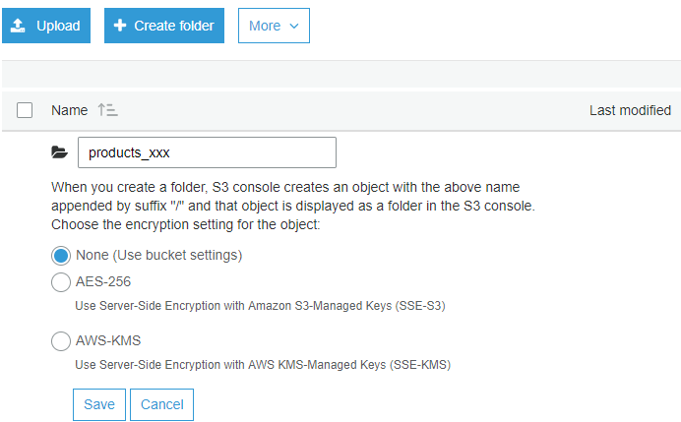
S3
Create S3 bucket folder
Create a folder called products_XXX

Slide 33
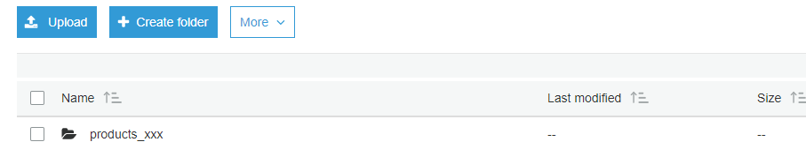
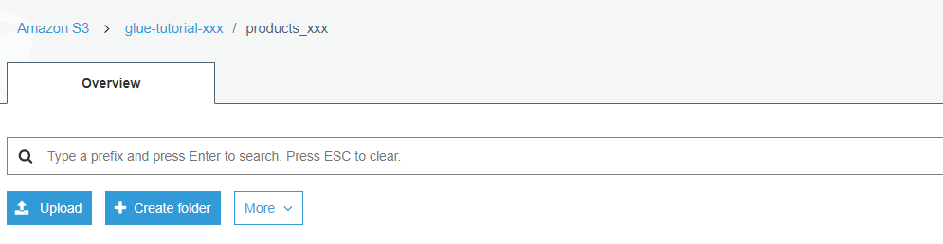
S3
Create S3 bucket with AWS Console

Slide 34
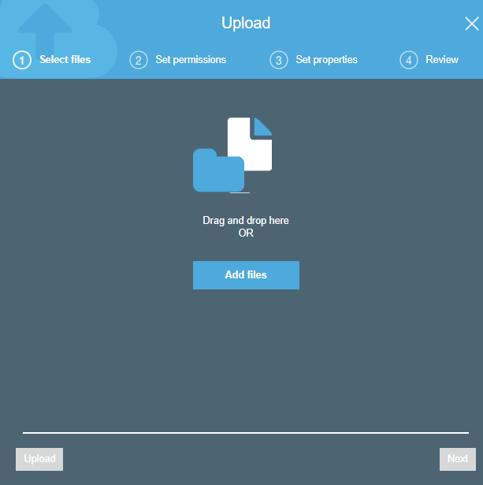
S3
Add file to S3 bucket with AWS Console
Add file from repository called “WA_Sales_Products.csv”

Slide 35
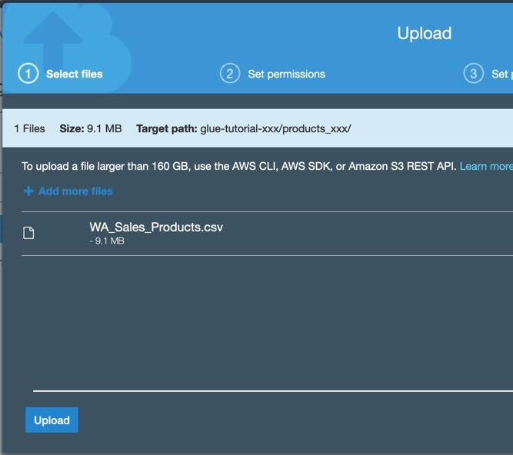
S3
Add file to S3 bucket with AWS Console
Add file from repository called “WA_Sales_Products.csv”

Slide 36
S3
Add file to S3 bucket with AWS CLI* (Alternative)
$ aws s3 cp <your-file-path>/aws-glue-tutorial/WA_Sales_Products.csv s3://glue-tutorial-XXX/products_XXX/
* Must install and set up AWS CLI in order to use this

Slide 37
Lab 2
Test Redshift Connection
Create S3 bucket
Add file to S3 bucket
(Use US-EAST-2/Ohio Region)
Notes:
lw

Slide 38

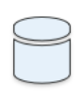

Glue Crawler
Data File
S3
Glue
Redshift
QuickSight
Glue Crawler
Athena
SQL Workbench/J

Slide 39
Glue Crawler
Scans file data to create metadata
Determines column names and data types
Creates a Glue Table
Notes:
Glue table accessible in athena

Slide 40
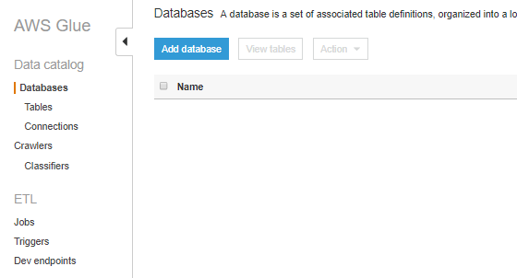
Glue
Create Glue Database
Create a new Database

Slide 41
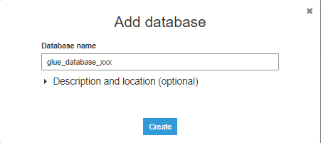
Glue
Create Glue Database
Give your database a name
“glue_database_XXX”

Slide 42
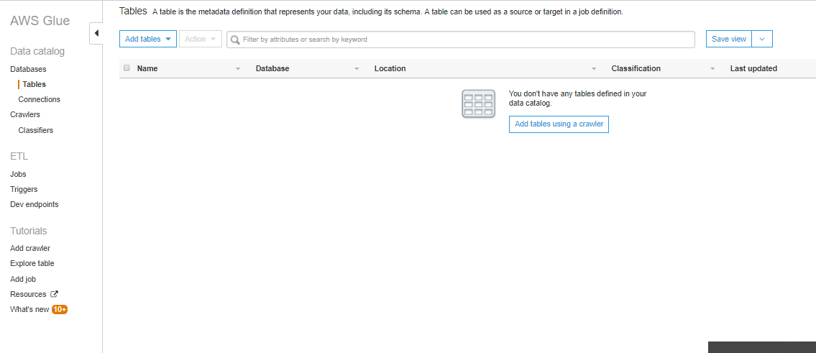
Glue Crawler
Create Table with Glue Crawler
Click on add tables to create a table
Create a table using a crawler
Notes:
You'll notice that there is an option to add the table manually, but you would have to type in the column names and types manually. A good option if your file doesn't have column names and types already

Slide 43
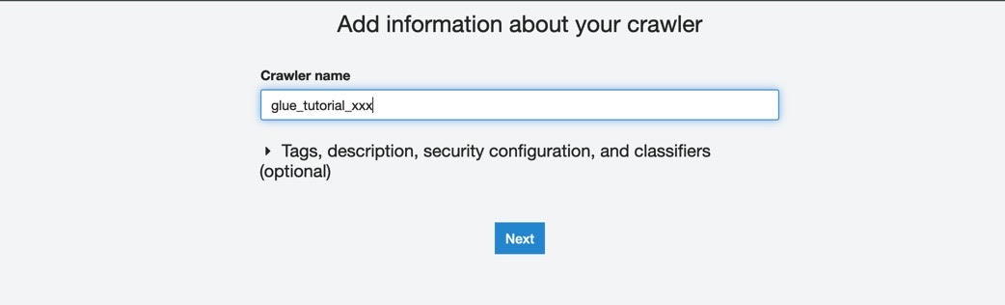
Glue Crawler
Create Table with Glue Crawler
Give your crawler a name, glue-tutorial-XXX

Slide 44
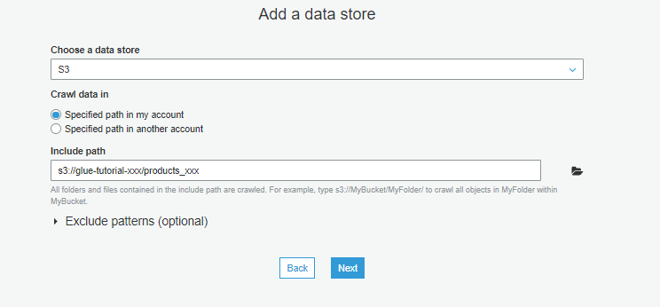
Glue Crawler
Choose where the table is going to look for data
Create Table with Glue Crawler
Specify the path for the table to search for in S3

Slide 45
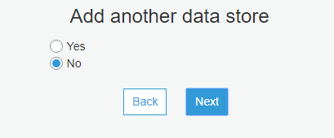
Glue Crawler
Create Table with Glue Crawler
We do not want to add another source of data

Slide 46
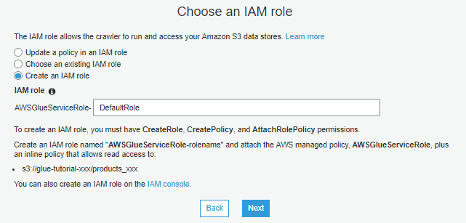
Glue Crawler
Create Table with Glue Crawler
Need to create role to access S3 bucket
Give your role a name
-xxx
Notes:
DefaultRole-xxx

Slide 47
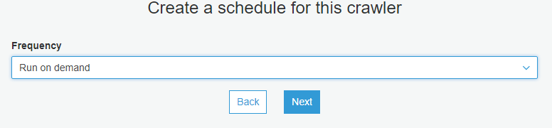
Glue Crawler
Create Table with Glue Crawler
Your crawler can run on either a timed schedule or on demand
Notes:
May want to run on a timed schedule if you receive new data on a regular basis

Slide 48
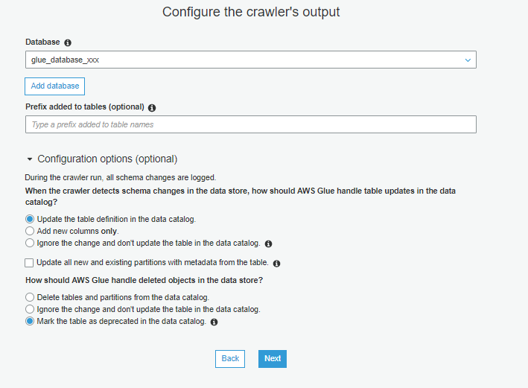
Glue Crawler
Create Table with Glue Crawler
Choose the database you created for your table to be in
The crawler will update the table if there is a change in the data
This will leave the table where it is but mark it as deprecated

Slide 49
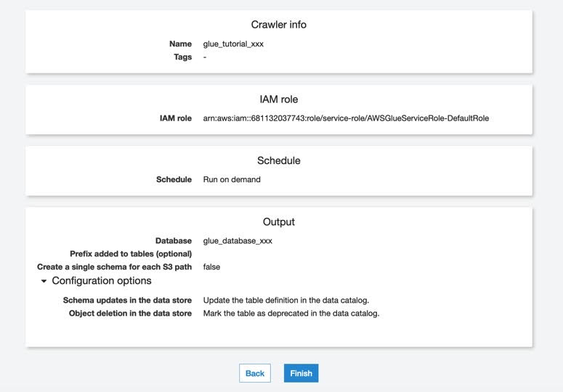
Glue Crawler
Create Table with Glue Crawler

Slide 50
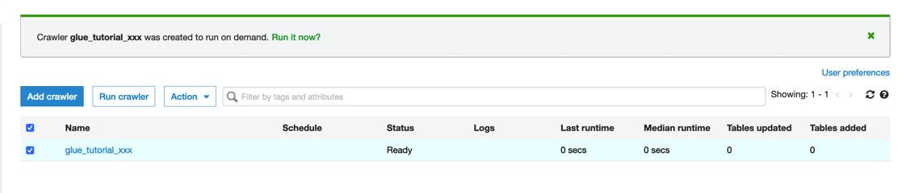
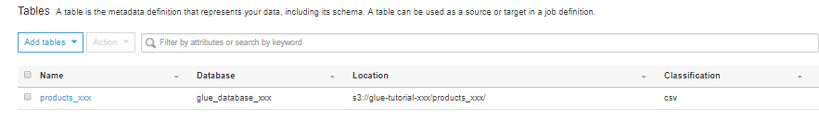
Glue Crawler
Create Table with Glue Crawler
Run your crawler
Your table should be in the Tables tab

Slide 51
Athena
Data File
S3
Glue
Redshift
QuickSight
Glue Crawler
Athena
SQL Workbench/j

Slide 52
Athena
Interactive query service used to analyze data
Data stored in S3
Run queries to verify your data is stored correctly

Slide 53
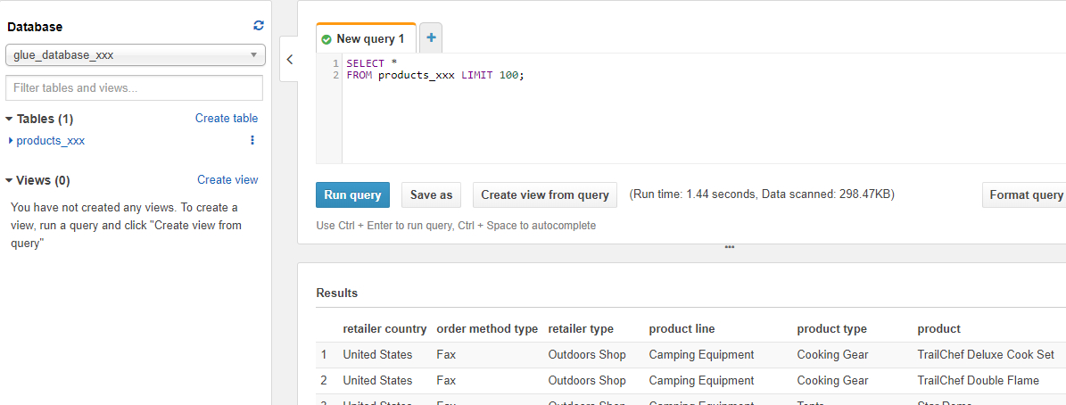
Athena
Run an SQL select query to verify data populating correctly
SELECT * FROM products_xxx LIMIT 100;

Slide 54
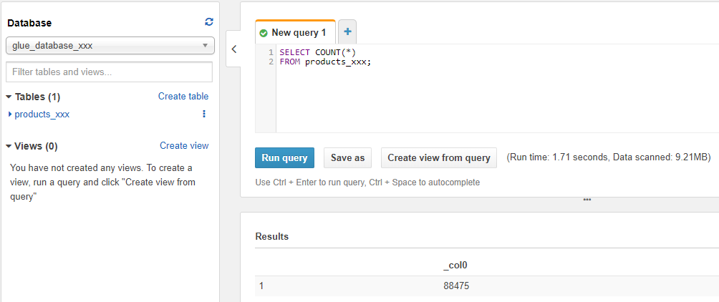
Athena
Run an SQL count query to verify all data is there
SELECT COUNT(*) FROM products_xxx;

Slide 55
Lab 3
Create/Run Glue Crawler
Query using Athena
(Use US-EAST-2/Ohio Region)
Notes:
jz

Slide 56

Glue
Data File
S3
Glue
Redshift
QuickSight
Glue Crawler
Athena
SQL Workbench/j
Notes:
Data iis n Glue table, but querying data in Redshift is faster

Slide 57

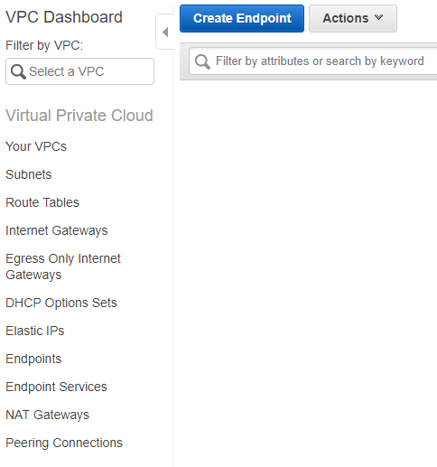
VPC
Create a S3 endpoint
We need to create a S3 endpoint for Glue to access S3
Notes:
Create private ip address for AWS Glue to access S3 data without exposing to the public
If using our shared AWS account, we have it done already since this only needs to be done once.

Slide 58
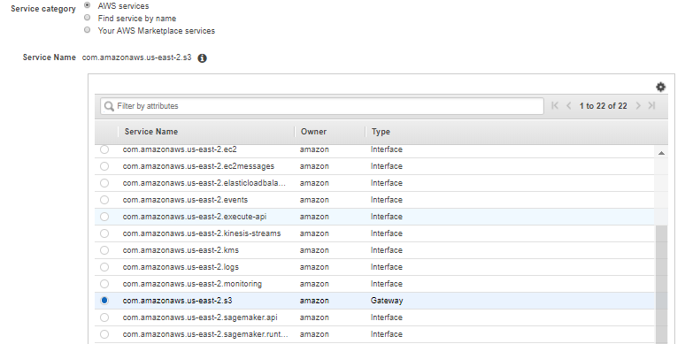
VPC
Create a S3 endpoint
Select the S3 Service for Glue to access S3

Slide 59
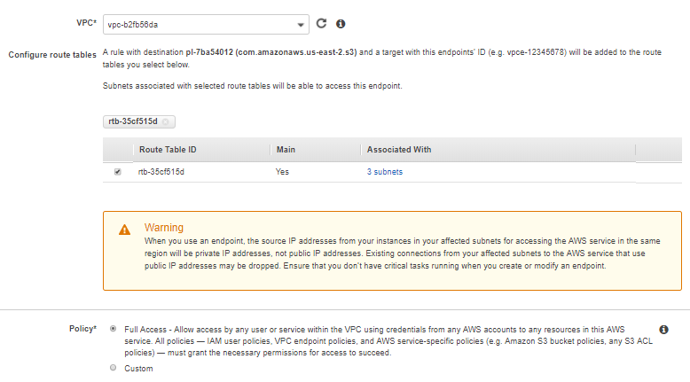
VPC
Create a S3 endpoint
Choose VPC
Choose to add to the Route Table

Slide 60
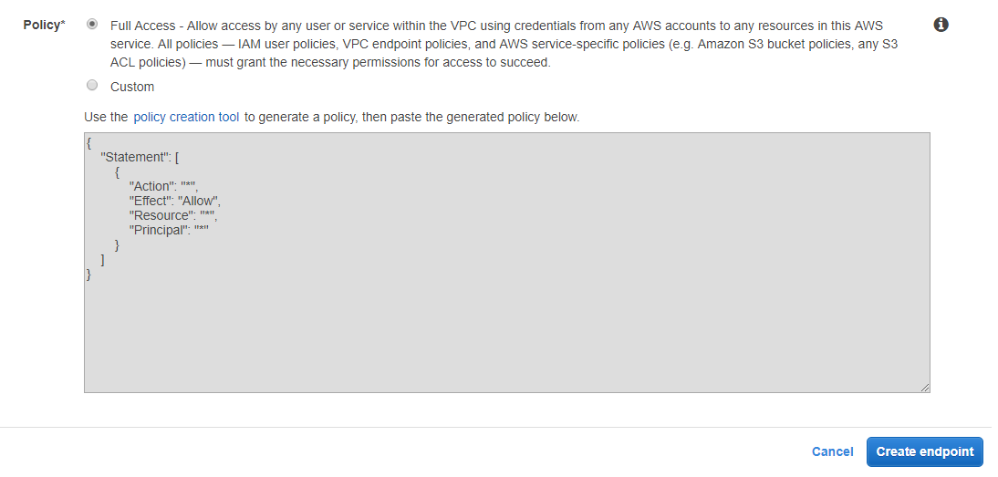
VPC
Create a S3 endpoint

Slide 61
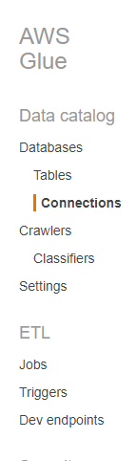
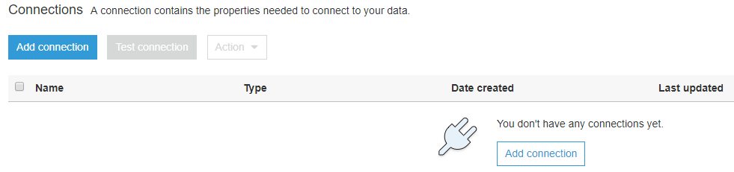
Glue
Create a connection to Redshift
Click on “Add Connection” to create a connection to the Redshift cluster
Notes:
To begin, we need to setup a connection to Redshift with Glue. Reminder Redshift is a datawarehouse

Slide 62

Glue
Name of the connection: glue-tutorial-XXX
Create a connection to Redshift
The connection type should be Redshift

Slide 63

Glue
Create a connection to Redshift
Name of the cluster: glue-tutorial-XXX
Username and password created for Redshift
Name of the database:
glue_tutorial_database_xxx

Slide 64

Glue
Create a connection to Redshift

Slide 65

Glue
Test the connection to Redshift
Select newly created connection
Notes:
DefaultRole-xxx

Slide 66

Glue
Test the connection to Redshift
Select your recently created IAM role
-xxx
Notes:
DefaultRole-xxx

Slide 67

Glue
Test the connection to Redshift

Slide 68
Lab 4
Create S3 Endpoint
Add Redshift Connection
Test Redshift Connection
(Use US-EAST-2/ Ohio Region)
Notes:
lw

Slide 69


Glue
Data File
S3
Glue
Redshift
QuickSight
Glue Crawler
Athena
SQL Workbench/j

Slide 70

Glue
Create a Glue job

Slide 71

Glue
Give your job a name: glue_tutorial_XXX
Create a Glue job
Give your job a role to perform the actions necessary to run
The language used to write the script
-xxx
Give your script a name glue_tutorial_XXX
Create a new blank script
This is where a temporary script is generated when the script is being edited
The location where your script will be placed in S3
Notes:
DefaultRole-xxx

Slide 72

Glue
Create a Glue job
DPU = Data Processing Unit. Glue jobs are charged per DPU hour. Change to 2
Job automatically stops after set time
Notes:
Timeout set to about 2 days initially

Slide 73

Glue
Create a Glue job
Parameters:
--REDSHIFT_DB_NAME glue_tutorial_database_xxx
--REDSHIFT_TABLE_NAME products_redshift_table_xxx
--SCHEMA_NAME sales_redshift_schema_xxx
--GLUE_DB_NAME
glue_database_xxx
--GLUE_TABLE_NAME
products_xxx
--CONNECTION_NAME
glue_tutorial_xxx
Parameterize values to be used in the script
Notes:
Note that the keys will need to have 2 dashes in front. This is just part of the glue syntax

Slide 74

Glue
Create a Glue job
Select the Redshift connection that you want to use: glue-tutorial-XXX
Notes:
Select the Redshift connection setup before

Slide 75
Glue
Writing the Script
Notes:
This code all comes pre-generated with the “empty script”
AWS Glue uses PySpark which is python for Apache Spark. Spark is an analytics engine for large scale data processing.

Slide 76
Glue
PySpark is a service that allows the developer to perform data analysis on the data that is being used.
Writing the Script
import sys
from awsglue.transforms import *
from awsglue.utils import getResolvedOptions
from pyspark.context import SparkContext
from awsglue.context import GlueContext
from awsglue.dynamicframe import DynamicFrame
from awsglue.job import Job
from pyspark.sql.functions import *
from pyspark.sql.types import *
from datetime import datetime
args = getResolvedOptions(sys.argv, ['TempDir', 'JOB_NAME', 'REDSHIFT_DB_NAME', ‘REDSHIFT_TABLE_NAME’, ‘GLUE_DB_NAME’, ‘GLUE_TABLE_NAME’, 'SCHEMA_NAME’, 'CONNECTION_NAME’])
Include SQL functions, types, and datetime to use later
Add the parameters that were passed into the Glue job
Notes:
AWS Glue uses PySpark which is python for Apache Spark. Spark is an analytics engine for large scale data processing.

Slide 77
Glue
This is setting up the Spark and Glue environment to be able to interact with the data
Writing the Script
…
sc = SparkContext()
glueContext = GlueContext(sc)
spark = glueContext.spark_session
job = Job(glueContext)
job.init(args['JOB_NAME'], args)
datasource = glueContext.create_dynamic_frame.from_catalog(
database = args[‘GLUE_DB_NAME'],
table_name = args[‘GLUE_TABLE_NAME']
)
The data will be written to the datasource as a DynamicFrame
These are the database and the table that we created in Glue
Notes:
Dynamic Frame is Glue’s version of a table. It is designed to work with Spark’s Data Frame, which is Spark’s version of a table.

Slide 78
Glue
Writing the Script
sourcedata needs to be set to a Data Frame
...
# Convert to PySpark Data Frame
sourcedata = datasource.toDF()
split_col = split(sourcedata["quarter"], " ")
sourcedata = sourcedata.withColumn("quarter new", split_col.getItem(0))
sourcedata = sourcedata.withColumn("profit", col("revenue")*col("gross margin"))
sourcedata = sourcedata.withColumn(“current date", current_date())
# Convert back to Glue Dynamic Frame
datasource = DynamicFrame.fromDF(sourcedata, glueContext, "datasource")
This is where the transformations happen
Convert back to a Dynamic Frame
Notes:
Glue Dynamic Frame, Pyspark Data Frame
The DynamicFrame needs to be changed in to a dataframe in order for Pyspark to be able to do transformations on it. Dynamic Frame is Glue’s version of a table. It is designed to work with Spark’s Data Frame, which is Spark’s version of a table.
Transformations:
“quarter” column is using a split to remove the year from the quarter column which initially has “quarter year”
Creating “profit“ column with a calculation of “revenue” multiplied with “gross_margin”
Creating “timestamp” column with current date

Slide 79
Glue
Writing the Script
...
applymapping = ApplyMapping.apply(
frame = datasource,
mappings = [
("retailer country", "string", "retailer_country", "varchar(20)"),
("order method type", "string", "order_method_type", "varchar(15)"),
("retailer type", "string", "retailer_type", "varchar(30)"),
("product line", "string", "product_line", "varchar(30)"),
("product type", "string", "product_type", "varchar(30)"),
("product", "string", "product", "varchar(50)"),
("year", "bigint", "year", "varchar(4)"),
("quarter new", "string", "quarter", "varchar(2)"),
("revenue", "double", "revenue", "numeric"),
("quantity", "bigint", "quantity", "integer"),
("gross margin", "double", "gross_margin", "decimal(15,10)"),
("profit", "double", "profit", "numeric"),
(“current date", "date", “current_date", "date")
]
This is how the data in the DynamicFrame will be mapped to the columns in Redshift
Notes:
Mapping out AWS Glue Data in the Dynamic Frame to columns in Redshift
Column name and type in Glue maps out to what column name and type will be in Redshift

Slide 80
Glue
Writing the Script
...
# datasink (loading) using spark
datasink = glueContext.write_dynamic_frame.from_jdbc_conf(
frame = applymapping,
catalog_connection = args['CONNECTION_NAME'],
connection_options = {
"dbtable": "{}.{}".format(args['SCHEMA_NAME'], args[‘REDSHIFT_TABLE_NAME']),
"database": args['REDSHIFT_DB_NAME']
},
redshift_tmp_dir = args["TempDir"]
)
The datasink will connect to Redshift using the parameters given and load the data to Redshift
Notes:
Using datasink to connect with Redshift and load the data
Using parameters set from before to connect to the correct Redshift database, schema and table.

Slide 81
Redshift
Data File
S3
Glue
Redshift
QuickSight
Glue Crawler
Athena
SQL Workbench/J

Slide 82


Redshift
Create table
Add your own initials to the schema and table names
Run a SELECT to make sure your table was made and nothing is in it
Copy the SQL script from the repository into SQL Workbench

Slide 83


Glue
Run the Glue job
Go back to Glue and run your Glue job
When the job succeeds, check your Redshift table

Slide 84

Redshift
Verify data in the table

Slide 85
Lab 5
Create Glue Job
Redshift Schema and Table
Run Glue Job
Query Redshift
(Use US-EAST-2/Ohio Region)

Slide 86
Enhancements
Improve the versatility of your Glue job
Create a Glue Trigger
Automatically run the Glue job
Run multiple different Glue jobs
Control how resources can interact with other services
Create reports for business analytics with the data that was loaded with the Glue job.
Easily create, modify, and delete as well as move Glue jobs with a template

Slide 87



Glue Trigger
Automatically run Glue job using Lambda – a serverless function
Instead of running the Glue job manually, have it run automatically when a file is added to S3.
Do this using a Lambda.
Name the lambda and choose Python as the language

Slide 88

Glue Trigger
Automatically run Glue job using Lambda – a serverless function
Name the role and choose permissions for S3

Slide 89



Glue Trigger
Automatically run Glue job
using Lambda – a serverless function
You can set a Lambda to run when a file lands in an S3 bucket

Slide 90


Glue Trigger
Click here
Automatically run Glue job
using Lambda – a serverless function
Then make the Lambda run the Glue job.
Add code under ‘lambda_
function’
import boto3
def lambda_handler(event, context):
glue = boto3.client('glue’)
glueResponse = glue.start_job_run(JobName = "glue_tutorial_xxx")
Notes:
Notice that the name of the glue job is hardcoded in the lambda. It would be better if it could run different glue jobs based on the file. We could store that information in…

Slide 91



Glue Trigger
Run multiple different Glue jobs with DynamoDB – a non-relational database
The Lambda currently can only run one Glue job
It would be better if it could run different Glue jobs based on the file.
We could store that information in a DynamoDB table

Slide 92


Glue Trigger
Run multiple different Glue jobs with DynamoDB – a non-relational database
Enter the filename and the glue job that loads that file
glue_tutorial_xxx

Slide 93

Glue Trigger
Lambda receives an event from S3, which includes the ‘key’
Automatically run Glue job using Lambda
The Lambda can look up the filename in the DynamoDB table to find which Glue job to run
import boto3
def lambda_handler(event, context):
source_key_name = event['Records'][0]['s3']['object']['key']
filename = source_key_name.rsplit('/',1)[1].split('. ',1)[0]
dynamodb = boto3.resource('dynamodb')
table = dynamodb.Table('glue_triggers')
dynamodb_response = table.get_item(Key = {'filename': filename})
glue_job = dynamodb_response['Item']['glue_job']
glue = boto3.client('glue')
glue_response = glue.start_job_run(JobName = glue_job)
This returns the Glue job associated with that file, then we trigger that job
We get the filename from the key, then search the DynamoDB table with it

Slide 94


Glue Trigger
IAM Roles determine how a resource can interact with other services
However when we try to run this lambda, we get an AccessDeniedException
We need to add permission to the Lambda’s IAM Role to access DynamoDB and Glue

Slide 95



Glue Trigger
IAM Roles determine how a resource can interact with other services
Notes:
To add policies, we can select “Attach policies” and search through the AWS managed polices for the one we want. In this case, we want the DynamoDB Read Only Access.

Slide 96


Glue Trigger
IAM Roles determine how a resource can interact with other services
Notes:
For the glue permission, there isn’t a managed policy that fits what we need, so we can add an inline policy instead. We only need to allow one action, called StartJobRun. Now, our lambda will be able to access the DynamoDB table and start the Glue job.

Slide 97


Glue Trigger
Test the Lambda
Notes:
To test the Lambda, rename your file (you don’t actually have to change the name). Renaming a file counts the same as adding a new file, so it should trigger the lambda which should trigger the glue job. If not, check the logs in the lambda to see what went wrong.

Slide 98
Lab 6
Create Lambda
Create DynamoDB
Edit IAM Role
Test Lambda
(Use US-EAST-2/Ohio Region)

Slide 99
QUICKSIGHT
AWS Business Intelligence Tool
Data File
S3
Glue
Redshift
QuickSight
Glue Crawler
Athena
SQL Workbench/J

Slide 100
QUICKSIGHT
AWS Business Intelligence Tool
Cloud based Business Intelligence reporting tool
Build Reports from
Files in S3
Redshift
Athena
Notes:
Alternative to Tableau or Microsoft Power BI

Slide 101

QUICKSIGHT
AWS Business Intelligence Tool

Slide 102
QUICKSIGHT
AWS Business Intelligence Tool
Create Analysis
Create/Select data set
Select fields
Set field format
Add drill down layer
Select/change visual type
Publish to the dashboard

Slide 103

QUICKSIGHT
AWS Business Intelligence Tool
Notes:
EC2 Security Group

Slide 104

QUICKSIGHT
AWS Business Intelligence Tool

Slide 105

QUICKSIGHT
AWS Business Intelligence Tool

Slide 106


QUICKSIGHT
AWS Business Intelligence Tool

Slide 107

QUICKSIGHT
AWS Business Intelligence Tool

Slide 108

QUICKSIGHT
AWS Business Intelligence Tool

Slide 109

QUICKSIGHT
AWS Business Intelligence Tool

Slide 110

QUICKSIGHT
AWS Business Intelligence Tool
Give your data source a name
This is the Redshift endpoint without port number
This information comes from the Redshift Cluster

Slide 111

QUICKSIGHT
AWS Business Intelligence Tool

Slide 112

QUICKSIGHT
AWS Business Intelligence Tool

Slide 113

QUICKSIGHT
AWS Business Intelligence Tool
Select Add > Add title

Slide 114

QUICKSIGHT
AWS Business Intelligence Tool
Enter title

Slide 115

QUICKSIGHT
AWS Business Intelligence Tool
Choose product_line and revenue

Slide 116

QUICKSIGHT
AWS Business Intelligence Tool
Change the format of Revenue to Currency

Slide 117

QUICKSIGHT
AWS Business Intelligence Tool
Add product_type and product as drill down layer

Slide 118

QUICKSIGHT
AWS Business Intelligence Tool
Change Visual Type

Slide 119

QUICKSIGHT
AWS Business Intelligence Tool
Publish to Dashboard

Slide 120

QUICKSIGHT
AWS Business Intelligence Tool
Name the Dashboard and select Publish dashboard

Slide 121

QUICKSIGHT
AWS Business Intelligence Tool
Share the dashboard

Slide 122
Lab 7
Create QuickSight Account
Create Dataset
Create Analysis
Publish to Dashboard
Create More Analyses
(Use US-EAST-2/Ohio Region)

Slide 123

CLOUDFORMATION
Templates
Template used build the infrastructure for AWS resources
Use Case:
Build Glue job through Cloud Formation vs Glue console
Advantages
Easy to modify
Easy to create multiple Glue jobs with similar patterns
Easy to delete multiple related resources at once
Easy to deploy to a different account

Slide 124
CLOUDFORMATION
GlueJobName:
Type: String
Default: glue_tutorial
ScriptLocation:
Type: String
Default: "s3://glue-tutorial-XXX/products_XXX"
Resources: MyJob:
Type: AWS::Glue::Job
Properties:
Command:
Name: glueetl
ScriptLocation: !Ref ScriptLocation
AllocatedCapacity: 2
DefaultArguments:
"--REDSHIFT_DB_NAME": !Ref RedshiftDBName
"--SCHEMA_NAME": !Ref SchemaName
"--REDSHIFT_TABLE_NAME": !Ref RedshiftTableName
"--GLUE_TABLE_NAME": !Ref GlueTableName
"--CONNECTION_NAME": !Ref GlueConnectionName
"--GLUE_DB_NAME": !Ref GlueDatabaseName
ExecutionProperty:
MaxConcurrentRuns: 2
Connections: !Ref GlueConnectionName
MaxRetries: 0
Name: !Ref GlueJobName
Templates
AWSTemplateFormatVersion: "2010-09-09“
Parameters:
GlueDatabaseName:
Type: String
Default: glue_database_XXX
GlueConnectionName:
Type: String
Default: glue_tutorial_XXX
RedshiftDBName:
Type: String
Default: glue_tutorial_database_XXX
SchemaName:
Type: String
Default: sales_redshift_schema_XXX
RedshiftTableName:
Type: String
Default: products_redshift_table_XXX
GlueTableName:
Type: String
Default: products_glue_table_XXX

Slide 125
SUMMARY
AWS Data Workflow
Data File
S3
Glue
Redshift
QuickSight
Glue Crawler
Athena
SQL Workbench/J

Slide 126
Conclusion
Glue - AWS ETL Tool
Simple –
Use AWS for your ETL job
Less Setup
Flexible –
Good for developers as well as non-developers
Customizable
Cost Effective –
Cheaper than other ETL tools
Pay only when you use Glue

Slide 127
CLEAN UP
AWS
Delete the following resources:
Redshift Cluster *
S3 Bucket *
QuickSight Account *
DynamoDB Table*
Glue Job
Glue Database
Glue Table
Glue Connection
Lambda
* These services will accrue charges to your AWS account if not removed

Slide 128
RESOURCES
AWS Business Intelligence Tool
AWS Glue Documentation
https://aws.amazon.com/glue/
Pricing
Informatica
https://aws.amazon.com/marketplace/pp/B0752DY9DV?qid=1534179668153&sr=
0-1&ref_=srh_res_product_title
Glue
https://aws.amazon.com/glue/pricing/
Matillion
https://aws.amazon.com/marketplace/pp/B010ED5YF8
AWS Services Documentation
https://aws.amazon.com/documentation/
Hadoop vs AWS
https://www.trustradius.com/compare-products/amazon-web-services-vs-hadoop
https://databricks.com/blog/2017/05/31/top-5-reasons-for-choosing-s3-over-hdfs.html
https://data-flair.training/blogs/13-limitations-of-hadoop/

Slide 129
Thank You
Lydia White
Email: lwhite@manifestcorp.com
LinkedIn: https://www.linkedin.com/in/lydia-white-a30044138/
James Zhang
Email: jzhang@manifestcorp.com
LinkedIn: https://www.linkedin.com/in/jameslzhang/

